Slide 1
Universal Windows Platform

Slide 2
Tools
Visual Studio Professional/Enterprise
Visual Studio Community
Visual Studio Code
Other tools

Slide 3
What is UWP?
Evolution of the Windows Runtime (WinRT)
Deploy the same app across multiple device families
E.g., Desktop, mobile, IoT, Xbox, HoloLens
Responsive/adaptive UI
Sync experiences across devices
Data available everywhere
Devices can bring unique experiences
Notes:
Windows 10 introduces the Universal Windows Platform (UWP), which further evolves the Windows Runtime model and brings it into the Windows 10 unified core. As part of the core, the UWP now provides a common app platform available on every device that runs Windows 10. With this evolution, apps that target the UWP can call not only the WinRT APIs that are common to all devices, but also APIs (including Win32 and .NET APIs) that are specific to the device family the app is running on. The UWP provides a guaranteed core API layer across devices. This means you can create a single app package that can be installed onto a wide range of devices. And, with that single app package, the Windows Store provides a unified distribution channel to reach all the device types your app can run on.

Slide 4
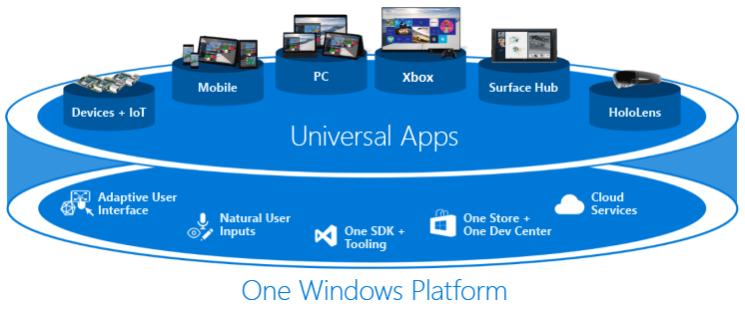
What is UWP?
Notes:
Because your UWP app runs on a wide variety of devices with different form factors and input modalities, you want it to be tailored to each device and be able to unlock the unique capabilities of each device. Devices add their own unique APIs to the guaranteed API layer. You can write code to access those unique APIs conditionally so that your app lights up features specific to one type of device while presenting a different experience on other devices. Adaptive UI controls and new layout panels help you to tailor your UI across a broad range of screen resolutions.

Slide 5
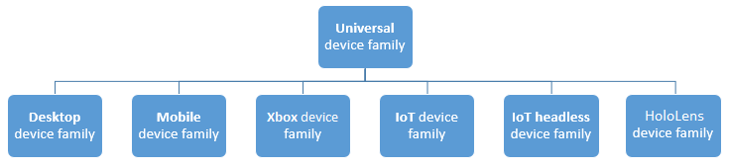
Device Families
Notes:
A device family is a set of APIs collected together and given a name and a version number. A device family is the foundation of an OS. PCs run the desktop OS, which is based on the desktop device family. Phones and tablets, etc., run the mobile OS, which is based on the mobile device family.
The universal device family is special. It is not, directly, the foundation of any OS. Instead, the set of APIs in the universal device family is inherited by child device families. The universal device family APIs are thus guaranteed to be present in every OS and on every device.
You can write code that dynamically detects features that are present on a device.
There are two main consequences of making a device family choice: the API surface that can be called unconditionally by the app, and the number of devices the app can reach. These two factors involve tradeoffs and are inversely related.

Slide 6
Adaptive Code
Most of the Windows Runtime APIs your Universal 8.1 app already calls are implemented in the set of APIs known as the universal device family. But, some are implemented in extension SDKs, and Visual Studio only recognizes APIs that are implemented by your app's target device family or by any extension SDKs that you have referenced.

Slide 7
Adaptive UI - ???????
????

Slide 8
Some UWP Resources
http://dev.windows.com – below are found here:
UWP Community Toolkit
Guide to Universal Windows Platform (UWP) apps

Slide 9
Hello UWP
Sample Application

